Slide 1












Cyber Security
Computer
Security
Mobile Security
Threat Protection
Cloud Security
Cyber Security
Ensures National Security
Wireless Security
Divice
Security
Data Protection
Information Security
Network Security
Identity Management

Slide 2
Cyber Security
SUBMITTED to | SUBMITTED BY | ID NO.
Mr. Tashreef Muhammad | Taus Elham Tamjid | 2026000000195
LECTURER AT DEPARTMENT OF CSE | Ratul Ahmmed | 2026000000189
SOUTHEAST UNIVERSITY | Saif Ibn Rashid Tahsin | 2026000000185
 | Sumaiya Akter Sayma | 2026000000205

Slide 3
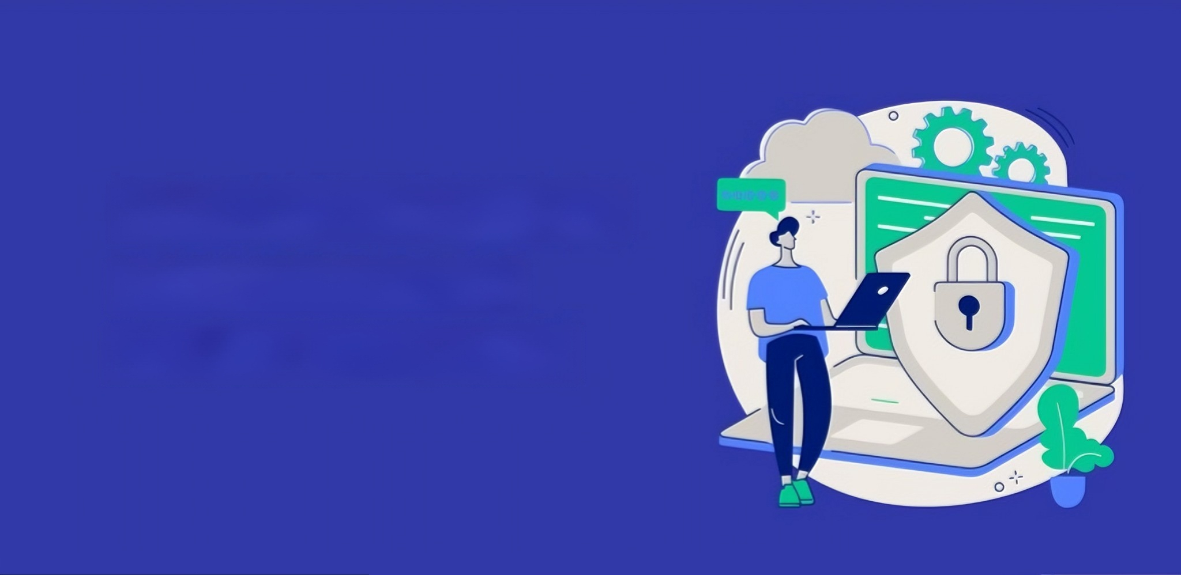
INTRODUCTION
Cyber refers to anything related to computers, information technology, networks, and the internet. It represents the digital environment where people communicate, share information, and perform various online activities through interconnected systems and networks.Cyber Security is the practice of protecting computers, networks, software, and data from unauthorized access, attacks, damage, or theft. It helps ensure the confidentiality, integrity, and availability of information while safeguarding individuals and organizations from cyber threats.
(Oxford Reference, 2023).

Slide 4
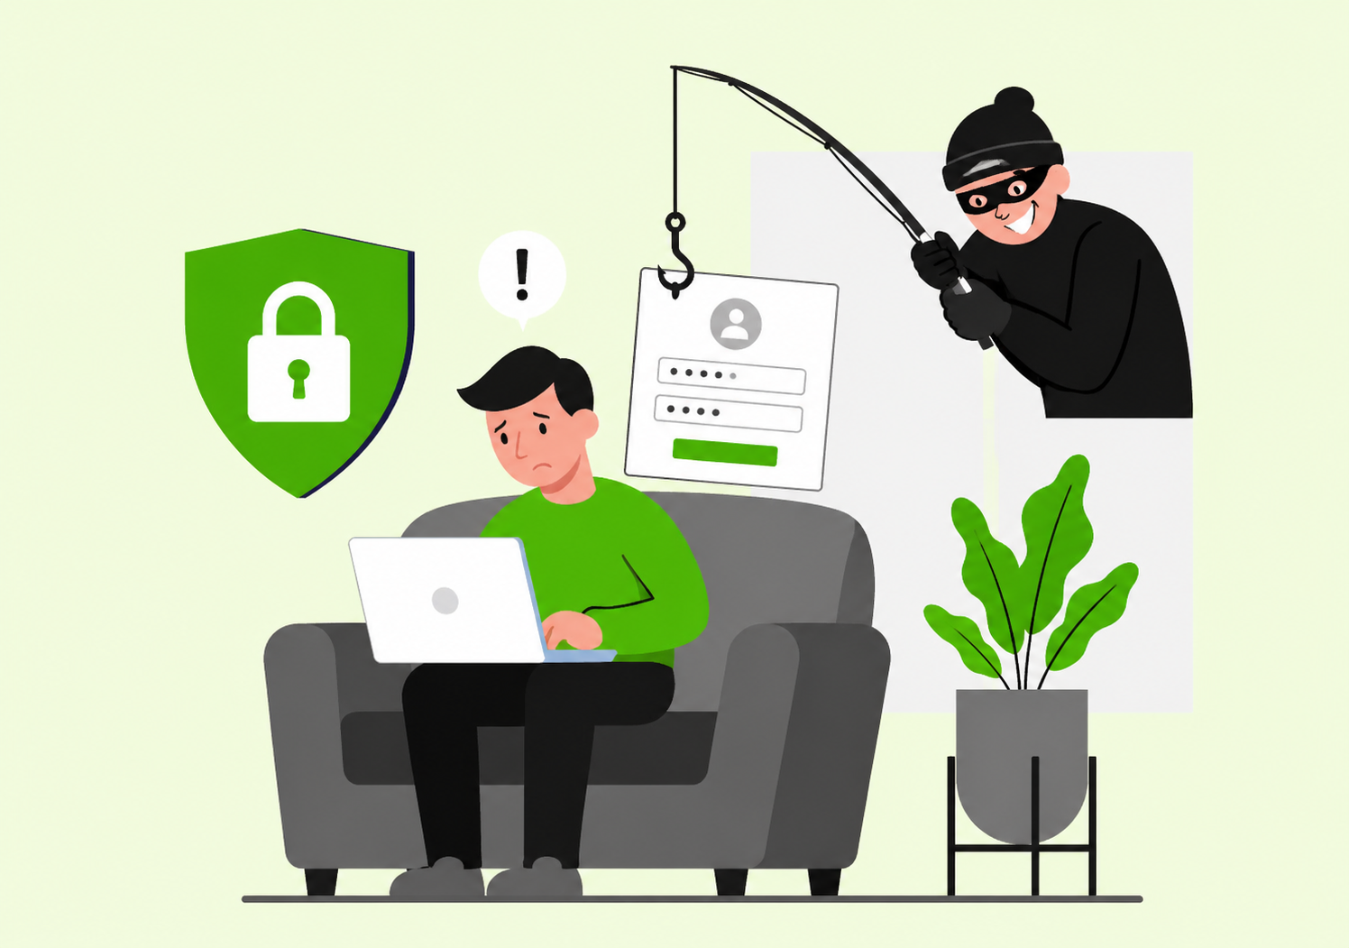
Cyber Crime
Cyber crime refers to any illegal activity that is carried out using computers, networks, or the internet, where the computer may be the target, tool, or both. It includes activities such as hacking, identity theft, online fraud, and data breaches.
Cyber crime is defined as criminal activities involving computers and digital networks (UNODC, 2021).

Slide 5
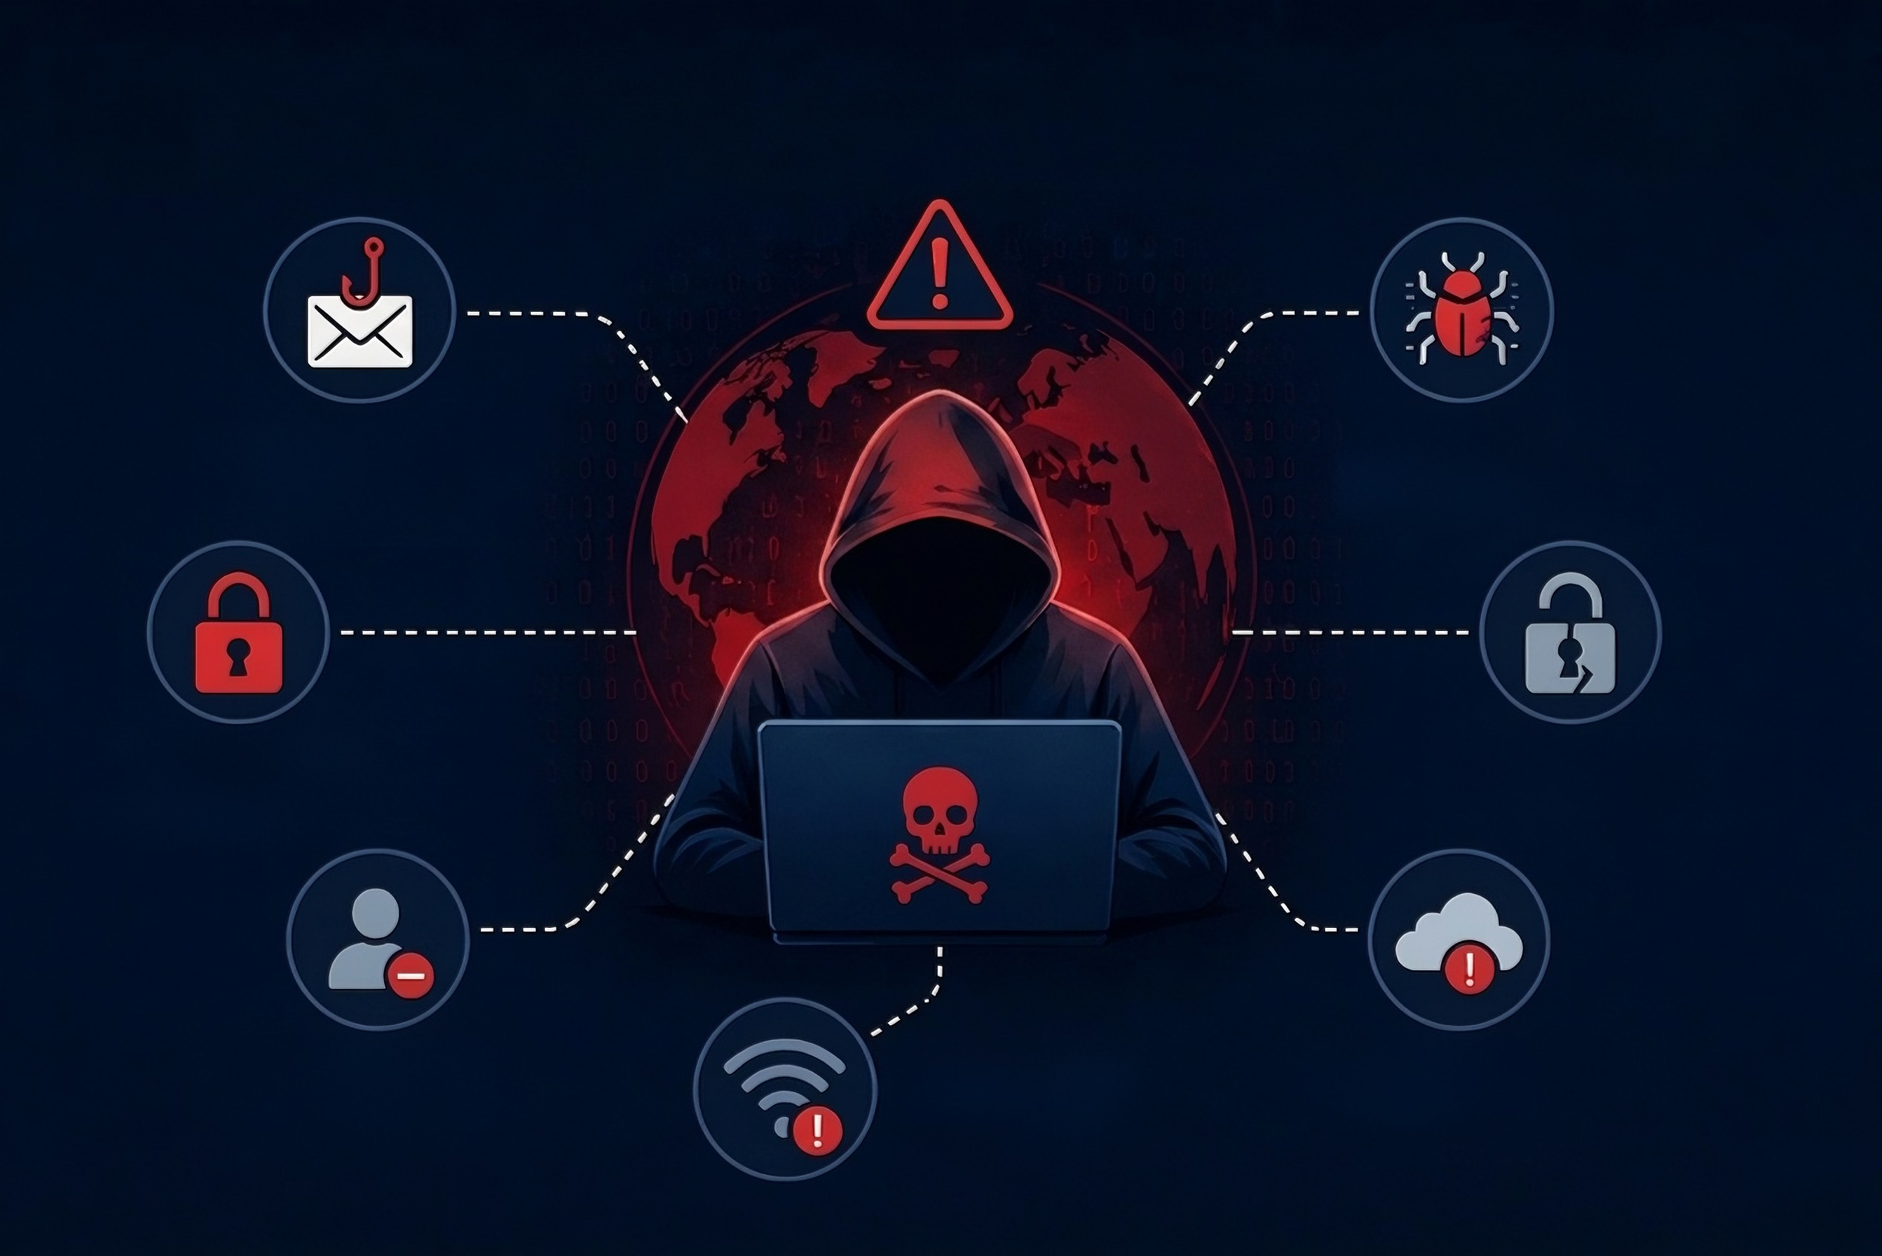
Major Cyber Security Problem
PHISHING ATTACKS
Tricking users to steal sensitive information
MALWARE
Malicious software designed to damage or steal data.
RANSOMWARE
Malware that locks data and demands payment.
DATA BREACHES
Unauthorized access to sensitive data.
INSIDER THREATS
Malicious or negligent actions by trusted insiders.
WEAK PASSWORDS
Easy-to-guess passwords compromise accounts.
UNSECURED SYSTEMS
Vulnerabilities in systems and applications.

Slide 6








Advantages of Cyber Security
Data Protection
Protects personal and business information from hackers.
Business Security
Protects company data and builds trust.
Safe Online Transactions
Ensures secure online banking and payments.
Protection from Cyber Attacks
Prevents viruses, malware, and hacking.
User Confidence
Increases trust in digital platforms.

Slide 7








Real-Life Example of Cyber Attack
LinkedIn (2012)
Over 160 million user passwords were stolen and leaked on the dark web.
Yahoo (2013-14)
The largest breach in history, affecting 3 billion user accounts.
Equifax
Equifax (2017)
Personal data of 147 million people was stolen due to a software vulnerability.
Bangladesh Bank (2016)
Hackers attempted to steal $81 million using the SWIFT network.
Uber (2022)
An 18-year-old hacker used social engineering to access Uber's internal cloud systems.
SolarWinds (2020)
A sophisticated supply chain attack that compromised major U.S. government agencies.
Adobe (2013)
Stole data for 38 million users, including encrypted credit card information,
Target (2013 Breach)
Target experienced a major breach where around 40 million credit and debit card details of customers were stolen.

Slide 8
Statistical Analysis of Cyber Threats
Cyber Attack Type | Percentage (%)
Phishing | 40
Malware | 25
Ransomware | 15
DDoS Attacks | 12
Password Attacks | 8
According to the dataset, Phishing attacks account for the highest percentage (40%), followed by Malware (25%). This chart highlights the most common cyber security threats and emphasizes the importance of effective security measures.

Slide 9

Conclusion
Cyber Security is essential for protecting computers, networks, and data from cyber threats. It helps ensure privacy, secure communication, and safe online activities. As technology continues to grow, strong cyber security practices are necessary to create a safer digital environment.
By increasing awareness and following security measures, individuals and organizations can reduce cyber risks and use technology more safely.

Slide 10
AI Usage Log
Tool Used | Purpose | Example Prompt (Short) | Output Used | Modification Done | Verification Method | Who Used It
ChatGPT & Gemini | Presentation Structure, Design & Data Integration | "Generate a pro-tier cybersecurity slide deck structure with technical definitions." | Presentation layout & high-end formatting suggestions | Lead Architect: Custom-engineered all professional slide layouts, visual themes, and integrated the Excel statistical chart | Manually verified chart percentages and logical presentation flow. | 2026000000195
Grok AI | Data Acquisition | "Fetch 2024 statistics on phishing and ransomware breaches." | Threat percentages & attack numbers | Summarized historical breach data for the case study sections. | Cross-checked with IBM Security & Kaspersky reports. | 2026000000189
NotebookLM | Literature Review | "Summarize mitigation steps from NIST PDF." | NIST framework summaries | Extracted core points for strategic defense. | Verified with official NIST documentation. | 2026000000185
NotebookLM | Academic Research | "Format NIST bibliography." | Structured reference lists | Formatted final academic bibliography. | Cross-checked with textbook bibliography. | 2026000000205

Slide 11
References
National Institute of Standards and Technology (NIST). (2020). Framework for Improving Critical Infrastructure Cybersecurity. U.S. Department of Commerce. https://www.nist.gov
United Nations Office on Drugs and Crime (UNODC). (2021). Comprehensive Study on Cybercrime. United Nations. https://www.unodc.org
Oxford Reference. (2023). A Dictionary of Elements of Cyber Security. Oxford University Press.
IBM Security. (2024). Cost of a Data Breach Report 2024. IBM Corporation. https://www.ibm.com/reports/data-breach
Reuters. (2016). How Swifts and Hackers Aligned to Rob Bangladesh Bank of $81 Million. Reuters News. https://www.reuters.com

Slide 12
Thank You

